Slide 1
Computer Organisation 1
  Secondary Storage
Sébastien Piccand
sebastien.piccand@ul.ie

Slide 2
What is secondary storage?
‘Secondary storage devices are used to save, to back up, and even transport files consisting of data or programs from one location or computer to another.’
Unlike primary storage like RAM (Random Access Memory), secondary storage is nonvolatile/permanent, i.e. it stays available even after the device has been turned off and on again.
Often simply called “storage”
Notes:
From http://www.aimglobal.org/technologies/RFID/what_is_rfid.asp
Some notes in this talk have also been taken from Tanenbaum, A. Structured Computer Organisation, 2006

Slide 3
Why study secondary storage?
Choosing the best medium for a particular purpose
General knowledge in computer science
Notes:
From http://www.aimglobal.org/technologies/RFID/what_is_rfid.asp
Some notes in this talk have also been taken from Tanenbaum, A. Structured Computer Organisation, 2006

Slide 4
Technologies
Magnetic storage
  Floppy, Zip disk, Hard drives, Tapes
Optical storage
  CD, DVD, Blue-Ray, HD-DVD…
Solid state memory
  USB key, Memory cards for mobile phones/digital cameras, Solid State Drives, MP3 players

Slide 5
Characteristics
Medium
Capacity
Writing ability
Performance
  Transfer rate/Access speed
Reliability

Slide 6
Characteristics
Medium
  This is the physical support
  Soft/hard
    floppy disks, CD, hard drive
  Shape
    Square, round
  Size or dimension
    MP3 player/ external hard drive

Slide 7
Characteristics
Capacity
  The amount of data it can store
  1 Byte = 8 bits (0 or 1)
  Typical document sizes
    Text document: 4 kB
    Audio track: 50 MB (CD)/ 4MB (MP3)
    Photo 5Mp (JPG): 1.5 MB
    Video (2h, DVD): 4 GB
    Video (2h, MPEG4): 650 MB

Slide 8
Characteristics
Writing ability
  Read only
    Commercial floppy disks
    Commercial CD-ROM, CD-Audio, DVD
  Write once
    CD-R, DVD-R, DVD+R
  Multiple write
    CD-RW, DVD-RW, DVD+RW, Hard drive, MP3 player, USB key

Slide 9
Characteristics
Performance
  Access speed
    Time to reach the location where the data is stored on the medium
    Tape vs CD
  Transfer rate
    Amount of information extracted/written per unit of time
    Usually faster to read than to write

Slide 10
Reliability
How data can be lost?
How to prevent this loss?

Slide 11
Technologies
Magnetic storage
  Floppy, Zip disk, Hard drives, Tapes
Optical storage
  CD, DVD, Blue-Ray, HD-DVD
Solid state memory
  USB key, Memory cards for mobile phones/digital cameras, Solid State Drives, MP3 players

Slide 12
Magnetic storage
  Simple coding of the data
  Bit 0: charge –
  Bit 1: charge +
Actually a bit more complicated
  http://www.storagereview.com/guide/data_geom.html
Writing: affecting corresponding polarity
Reading: reading polarity

Slide 13
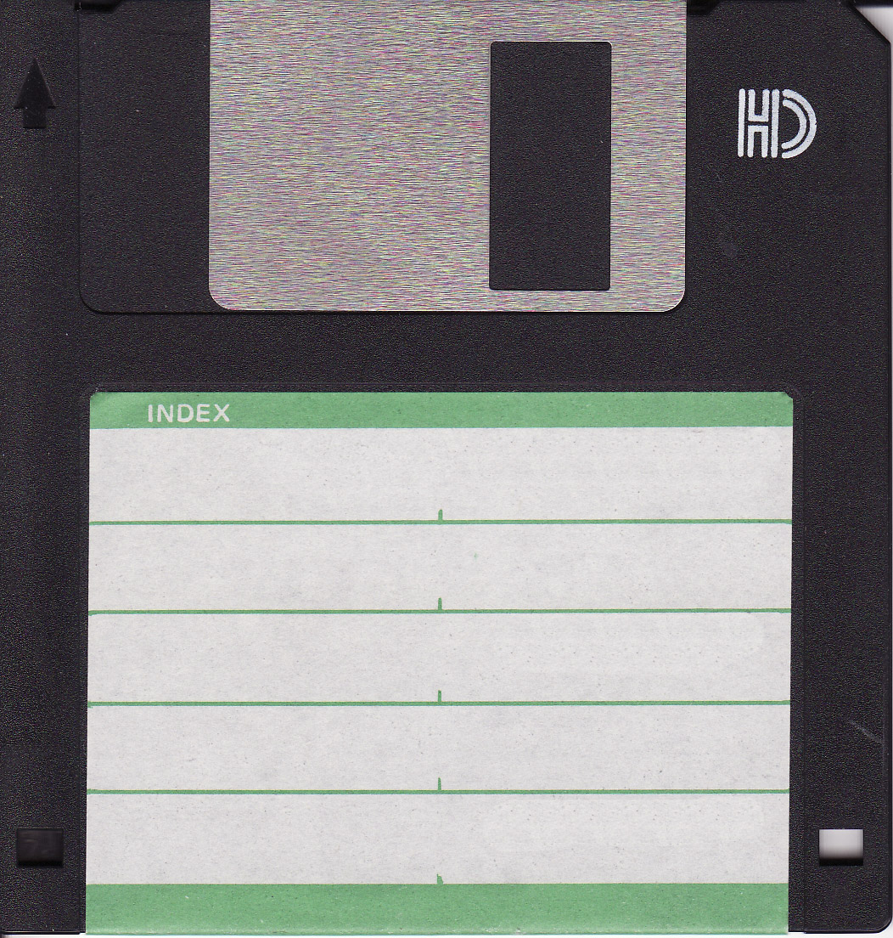
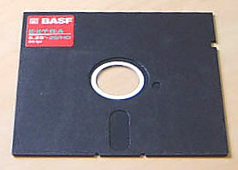
Magnetic storage: floppy disks

Slide 14
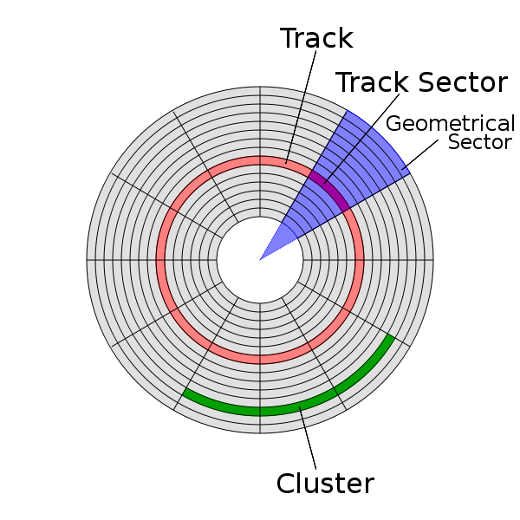
Magnetic storage: floppy disks
Structure
512 bytes per sector
  (+ error detection/correction
  + disk control)
* 18 sectors per track
* 80 tracks per side
* 2 sides
= 1,474,560 bytes per disk
Notes:
Track sector: 512 bytes

Slide 15
Magnetic storage: floppy disks
Capacity
  360kB (DD), 720kB (DD), 1.44MB (HD)
  100MB, 250MB, 750MB (Zip)
Dimension
  5.25'', 3.5'' (thicker for Zip)
Writing ability: can protect writing
Performance
  Transfer rate: 250/500/1000 kB/s
  Access time: 90 msec/ 30 msec (Zip)

Slide 16
Magnetic storage: floppy disks
Reliability
  Avoid
    Magnetic sources (speakers)
    Cold/Heat
    Water/Dirt
  Rather long lifetime if kept in a safe environment
  Very noisy

Slide 17
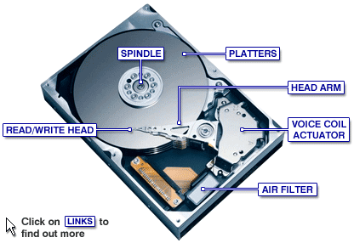
Magnetic storage: hard drive
Youtube Video

Slide 18
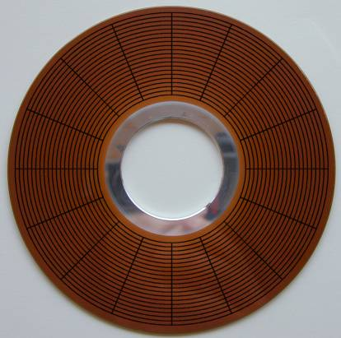
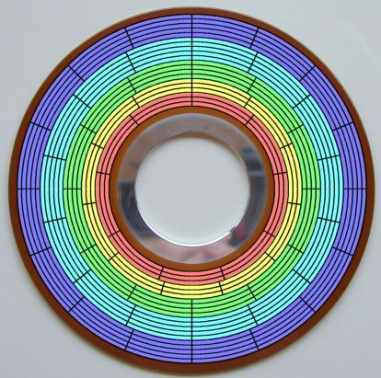
Magnetic storage: hard drive
Normal sectors
Zone Bit Recording

Slide 19
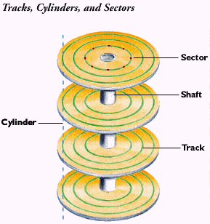
Magnetic storage: hard drive
Cylinder vs Track
  Multiple heads
  Small platters
  Improves access time

Slide 20
Magnetic storage: hard drive
Capacity
  2008: Up to 1.5 TB (1TB = 1000GB)
Dimension (of the platters)
  5.25'', 3.5''(desktop), 2.5'' (laptop), 1.8''
Writing ability: rewritable
Performance
  Rotating speed: 4,200 - 15,000 t/s
  Transfer rate: 40-120 MB/s
  Access time: 9 msec

Slide 21
Magnetic storage: hard drive
Reliability
  Avoid
    Shocks
    Dirt (don't open!)
    Heat/Water
  Noise: depends mostly on rotation speed
  Mechanical parts: will crash one day...
  Solutions
    Redundancy: multiple drives
    Backup: optical disks/digital tapes

Slide 22
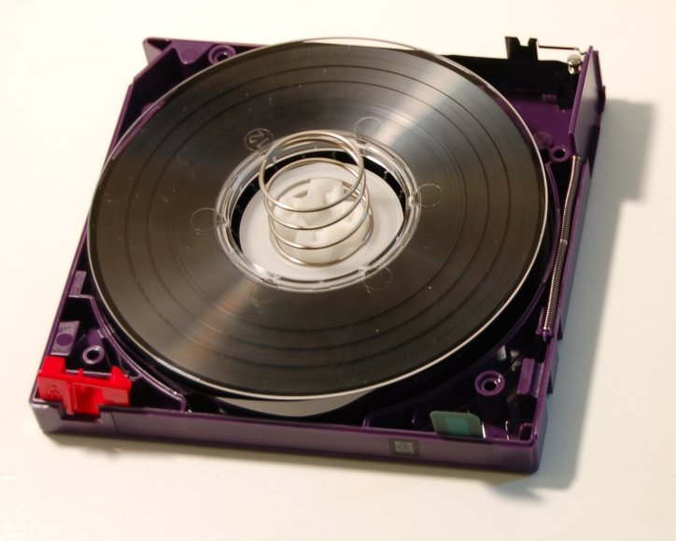
Magnetic storage: digital tape
http://en.wikipedia.org/wiki/Image:LTO2-cart-wo-top-shell.jpg

Slide 23
Magnetic storage: digital tape
DLT: Digital Linear Tape
  Being replaced by
LTO: Linear Tape-Open

Slide 24
Magnetic storage: digital tape
Capacity
  Up to 800 GB
Performance
  Transfer rate: up to 120 MB/sec
  Access time: worst case 98 sec (full rewind)
Writing ability
  mutliple write
  possibility to protect data from overwriting

Slide 25
Magnetic storage: digital tape
Reliability
  Long life: ~30 years (no moving parts)
  Avoid
    Heat/Cold/Water/Dirt
    Magnetic sources

Slide 26
Summary
Different technologies: magnetic, optical, solid state
  Different media: floppy disks, hard drives, digital tapes
    Important characteristics: capacity, writing ability, performance, reliability
Choosing the best medium for a particular purpose

Slide 27
Summary
Max capacity
Writing ability
Performance
Reliability
Floppy disk
1.44 kB (std)‏
750 MB (zip)‏
Multiple
Write lock
1 MB/sec
30/90 msec
Heat/Water/Dirt
Magnetic field
Hard drive
1.5 TB
Multiple
120 MB/sec
9 msec
Heat/Water/Dirt
Magnetic field
Shock
Digital tape
800 GB
Multiple
Write lock
120 MB/sec
40 sec
Heat/Water/Dirt
Magnetic field

Slide 28
Technologies
Magnetic storage
  Floppy, Zip disk, Hard drives, Tapes
Optical storage
  CD, DVD, Blue-Ray, HD-DVD...
Solid state memory
  USB key, Memory cards for mobile phones/digital cameras, Solid State Drives, MP3 players

Slide 29
Optical storage
http://www.cdrfaq.org/

